Slide 1


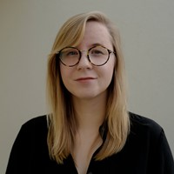


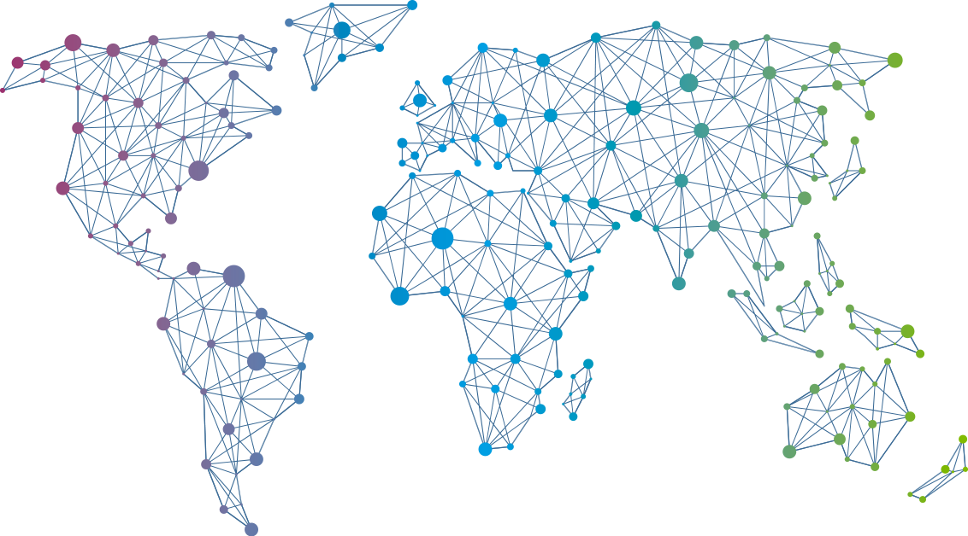

Speaker
Annie Talvasto
Top new CNCF projects to look out for
Kubernetes in the cloud - from zero to hero
Annie Talvasto
annietalvasto
September 16th & 17th
^{Online Event}
Powered By
International Conference

